Slide 1
Module 1
Java EE Web Applications

Slide 2
Topics to be covered
Servlet API Fundamentals
ServletContext
Session
Cookies
Request Redirection Techniques

Slide 3
Servlet
Servlet technology is used to create a web application (resides at server side and generates a dynamic web page).
Servlet technology is robust and scalable because of java language.
Before Servlet, CGI (Common Gateway Interface) scripting language was common as a server-side programming language.
There are many interfaces and classes in the Servlet API such as Servlet, GenericServlet, HttpServlet, ServletRequest, ServletResponse, etc.

Slide 4
What is a Servlet?
Servlet is a technology which is used to create a web application.
Servlet is an API that provides many interfaces and classes including documentation.
Servlet is an interface that must be implemented for creating any Servlet.
Servlet is a class that extends the capabilities of the servers and responds to the incoming requests. It can respond to any requests.
Servlet is a web component that is deployed on the server to create a dynamic web page.

Slide 5
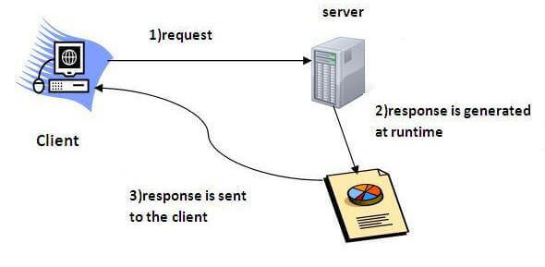
How servlet operates?

Slide 6
What is a web application?
A web application is an application accessible from the web.
A web application is composed of web components like Servlet, JSP, Filter, etc. and other elements such as HTML, CSS, and JavaScript.
The web components typically execute in Web Server and respond to the HTTP request.

Slide 7
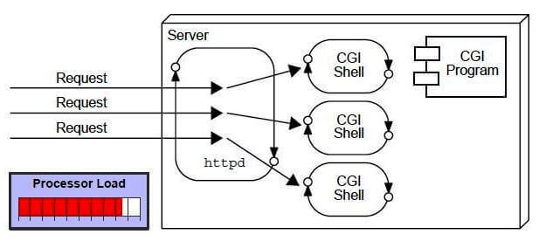
CGI (Common Gateway Interface)
CGI technology enables the web server to call an external program and pass HTTP request information to the external program to process the request. For each request, it starts a new process.

Slide 8
Disadvantages of CGI
If the number of clients increases, it takes more time for sending the response.
For each request, it starts a process, and the web server is limited to start processes.
It uses platform dependent language e.g. C, C++, perl.

Slide 9
Advantages of Servlet
There are many advantages of Servlet over CGI. The web container creates threads for handling the multiple requests to the Servlet. Threads have many benefits over the Processes such as they share a common memory area, lightweight, cost of communication between the threads are low. The advantages of Servlet are as follows:
Better performance: because it creates a thread for each request, not process.
Portability: because it uses Java language.
Robust: JVM manages Servlets, so we don't need to worry about the memory leak, garbage collection, etc.
Secure: because it uses java language.

Slide 10
Web Terminology
Servlet Terminology | Description
Website: static vs dynamic | It is a collection of related web pages that may contain text, images, audio and video.
HTTP | It is the data communication protocol used to establish communication between client and server.
HTTP Requests | It is the request send by the computer to a web server that contains all sorts of potentially interesting information.
Get vs Post | It gives the difference between GET and POST request.
Container | It is used in java for dynamically generating the web pages on the server side.
Server: Web vs Application | It is used to manage the network resources and for running the program or software that provides services.
Content Type | It is HTTP header that provides the description about what are you sending to the browser.

Slide 11
Website
Website is a collection of related web pages that may contain text, images, audio and video. The first page of a website is called home page. Each website has specific internet address (URL) that you need to enter in your browser to access a website.
Website is hosted on one or more servers and can be accessed by visiting its homepage using a computer network. A website is managed by its owner that can be an individual, company or an organization.
A website can be of two types:
Static Website
Dynamic Website

Slide 12
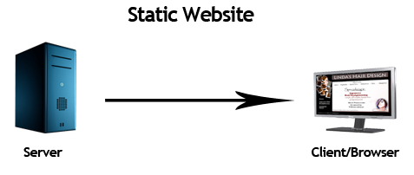
Static website
Static website is the basic type of website that is easy to create. You don't need the knowledge of web programming and database design to create a static website. Its web pages are coded in HTML.
The codes are fixed for each page so the information contained in the page does not change and it looks like a printed page.

Slide 13
Dynamic website
Dynamic website is a collection of dynamic web pages whose content changes dynamically. It accesses content from a database or Content Management System (CMS). Therefore, when you alter or update the content of the database, the content of the website is also altered or updated.
Dynamic website uses client-side scripting or server-side scripting, or both to generate dynamic content.
Client side scripting generates content at the client computer on the basis of user input. The web browser downloads the web page from the server and processes the code within the page to render information to the user.
In server side scripting, the software runs on the server and processing is completed in the server then plain pages are sent to the user.

Slide 14
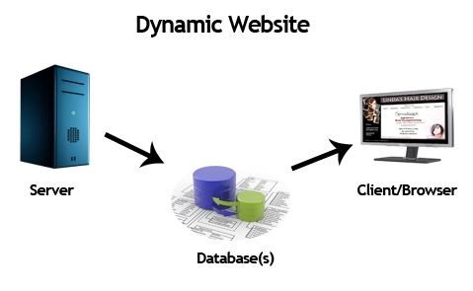
Dynamic Website

Slide 15
Static vs Dynamic
Static Website | Dynamic Website
Prebuilt content is same every time the page is loaded. | Content is generated quickly and changes regularly.
It uses the HTML code for developing a website. | It uses the server side languages such as PHP,SERVLET, JSP, and ASP.NET etc. for developing a website.
It sends exactly the same response for every request. | It may generate different HTML for each of the request.
The content is only changed when someone publishes and updates the file (sends it to the web server). | The page contains "server-side" code which allows the server to generate the unique content when the page is loaded.
Flexibility is the main advantage of static website. | Content Management System (CMS) is the main advantage of dynamic website.

Slide 16
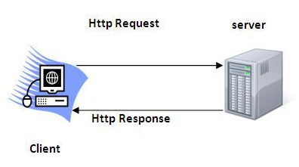
HTTP (Hyper Text Transfer Protocol)
The Hypertext Transfer Protocol (HTTP) is application-level protocol for collaborative, distributed, hypermedia information systems. It is the data communication protocol used to establish communication between client and server.
HTTP is TCP/IP based communication protocol, which is used to deliver the data like image files, query results, HTML files etc on the World Wide Web (WWW) with the default port is TCP 80. It provides the standardized way for computers to communicate with each other.

Slide 17
Characteristics of HTTP
It is the protocol that allows web servers and browsers to exchange data over the web.
It is a request response protocol.
It uses the reliable TCP connections by default on TCP port 80.
It is stateless means each request is considered as the new request. In other words, server doesn't recognize the user by default.

Slide 18
Features of HTTP
HTTP is media independent: It specifies that any type of media content can be sent by HTTP as long as both the server and the client can handle the data content.
HTTP is connectionless: It is a connectionless approach in which HTTP client i.e., a browser initiates the HTTP request and after the request is sent the client disconnects from server and waits for the response.
HTTP is stateless: The client and server are aware of each other during a current request only. Afterwards, both of them forget each other. Due to the stateless nature of protocol, neither the client nor the server can retain the information about different request across the web pages.

Slide 19
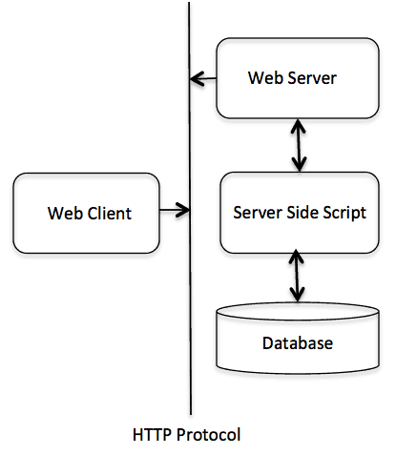
Architecture of HTTP
HTTP is request/response protocol which is based on client/server based architecture. In this protocol, web browser, search engines, etc. behave as HTTP clients and the Web server like Servlet behaves as a server

Slide 20
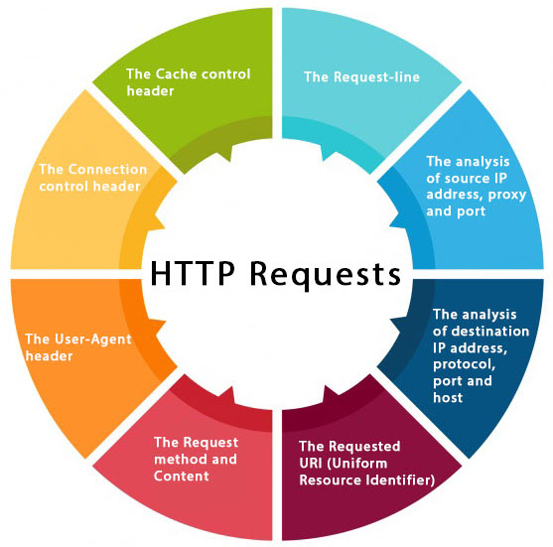
HTTP Requests
The request sent by the computer to a web server, contains all sorts of potentially interesting information; it is known as HTTP requests.
The HTTP client sends the request to the server in the form of request message which includes following information:

Slide 21
HTTP request methods
The HTTP request method indicates the method to be performed on the resource identified by the Requested URI (Uniform Resource Identifier). This method is case-sensitive and should be used in uppercase.
HTTP Request | Description
GET | Asks to get the resource at the requested URL.
POST | Asks the server to accept the body info attached. It is like GET request with extra info sent with the request.
HEAD | Asks for only the header part of whatever a GET would return. Just like GET but with no body.
TRACE | Asks for the loopback of the request message, for testing or troubleshooting.
PUT | Says to put the enclosed info (the body) at the requested URL.
DELETE | Says to delete the resource at the requested URL.
OPTIONS | Asks for a list of the HTTP methods to which the thing at the request URL can respond

Slide 22
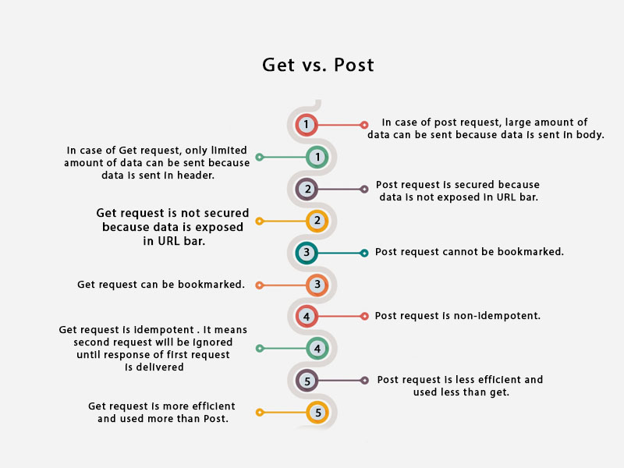
Get vs. Post

Slide 23
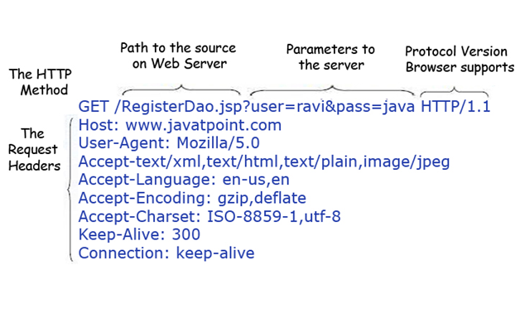
GET
GET- It requests the data from a specified resource. methods for the request-response between a server and client
The query string (name/value pairs) is sent inside the URL of a GET request:
GET/RegisterDao.jsp?name1=value1&name2=value2
features of GET requests are:
It remains in the browser history
It can be bookmarked
It can be cached
It have length restrictions
It should never be used when dealing with sensitive data
It should only be used for retrieving the data

Slide 24
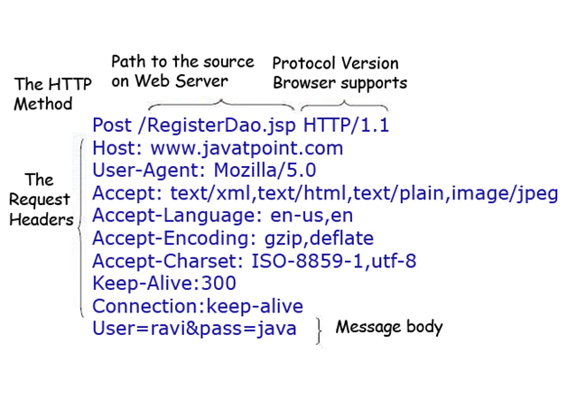
POST
The query string (name/value pairs) is sent in HTTP message body for a POST request:
POST/RegisterDao.jsp HTTP/1.1
Host: www. javatpoint.com
name1=value1&name2=value2
features of POST requests are:
This requests cannot be bookmarked
This requests have no restrictions on length of data
This requests are never cached
This requests do not retain in the browser history

Slide 25
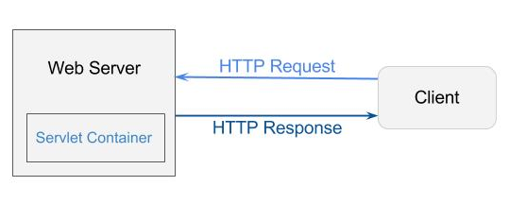
Servlet Container
It provides the runtime environment for JavaEE (j2ee) applications. The client/user can request only a static WebPages from the server. If the user wants to read the web pages as per input then the servlet container is used in java.
The servlet container is the part of web server which can be run in a separate process. We can classify the servlet container states in three types:

Slide 26
Servlet Container States
The servlet container is the part of web server which can be run in a separate process. We can classify the servlet container states in three types:
Standalone: It is typical Java-based servers in which the servlet container and the web servers are the integral part of a single program. For example:- Tomcat running by itself
In-process: It is separated from the web server, because a different program runs within the address space of the main server as a plug-in. For example:- Tomcat running inside the JBoss.
Out-of-process: The web server and servlet container are different programs which are run in a different process. For performing the communications between them, web server uses the plug-in provided by the servlet container.

Slide 27
The Servlet Container performs many operation
Life Cycle Management
Multithreaded support
Object Pooling
Security etc.

Slide 28
Server
Server is a device or a computer program that accepts and responds to the request made by other program, known as client. It is used to manage the network resources and for running the program or software that provides services.
There are two types of servers:
Web Server
Application Server

Slide 29
Web Server
Web server contains only web or servlet container. It can be used for servlet, jsp, struts, jsf etc. It can't be used for EJB.
It is a computer where the web content can be stored. In general web server can be used to host the web sites but there also used some other web servers also such as FTP, email, storage, gaming etc.
Examples of Web Servers are: Apache Tomcat and Resin.

Slide 30
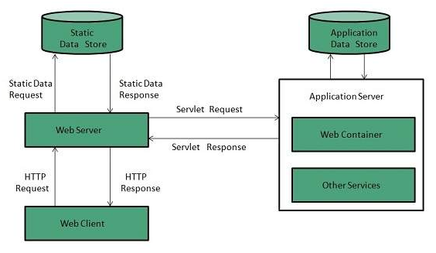
Web Server Working
It can respond to the client request in either of the following two possible ways:
Generating response by using the script and communicating with database.
Sending file to the client associated with the requested URL.
If the requested web page at the client side is not found, then web server will sends the HTTP response: Error 404 Not found.
When the web server searching the requested page if requested page is found then it will send to the client with an HTTP response.
If the client requests some other resources then web server will contact to application server and data is store for constructing the HTTP response.

Slide 31
Application Server
Application server contains Web and EJB containers. It can be used for servlet, jsp, struts, jsf, ejb etc. It is a component based product that lies in the middle-tier of a server centric architecture.
It provides the middleware services for state maintenance and security, along with persistence and data access. It is a type of server designed to install, operate and host associated services and applications for the IT services, end users and organizations.
The Example of Application Servers are:
JBoss: Open-source server from JBoss community.
Glassfish: Provided by Sun Microsystem. Now acquired by Oracle.
Weblogic: Provided by Oracle. It more secured.
Websphere: Provided by IBM.

Slide 32
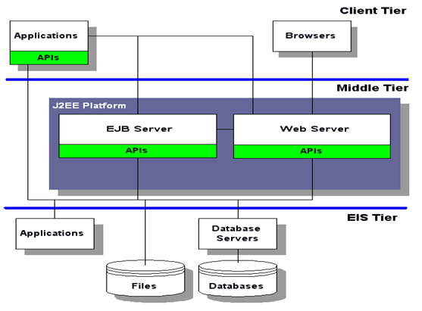
block diagram of Application Server

Slide 33
Content Type
Content Type is also known as MIME (Multipurpose internet Mail Extension)Type. It is a HTTP header that provides the description about what are you sending to the browser.
MIME is an internet standard that is used for extending the limited capabilities of email by allowing the insertion of sounds, images and text in a message.

Slide 34
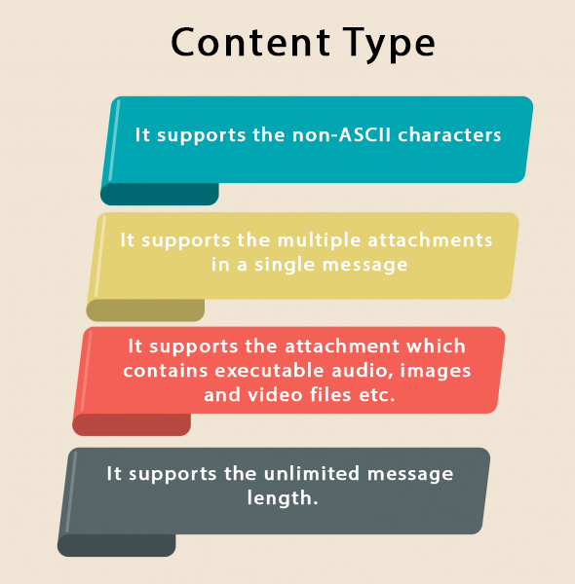
Components of method

Slide 35
List of Content Types
text/html
text/plain
application/msword
application/vnd.ms-excel
application/jar
application/pdf
application/octet-stream
application/x-zip
images/jpeg
images/png
images/gif
audio/mp3
video/mp4
video/quicktime etc.

Slide 36
Servlet API
The javax.servlet and javax.servlet.http packages represent interfaces and classes for servlet api.
The javax.servlet package contains many interfaces and classes that are used by the servlet or web container. These are not specific to any protocol.
The javax.servlet.http package contains interfaces and classes that are responsible for http requests only.

Slide 37
Interfaces in javax.servlet package
Servlet
ServletRequest
ServletResponse
RequestDispatcher
ServletConfig
ServletContext
SingleThreadModel
Filter
FilterConfig
FilterChain
ServletRequestListener
ServletRequestAttributeListener
ServletContextListener
ServletContextAttributeListener

Slide 38
Classes in javax.servlet package
GenericServlet
ServletInputStream
ServletOutputStream
ServletRequestWrapper
ServletResponseWrapper
ServletRequestEvent
ServletContextEvent
ServletRequestAttributeEvent
ServletContextAttributeEvent
ServletException
UnavailableException

Slide 39
Interfaces in javax.servlet.http package
HttpServletRequest
HttpServletResponse
HttpSession
HttpSessionListener
HttpSessionAttributeListener
HttpSessionBindingListener
HttpSessionActivationListener
HttpSessionContext (deprecated now)

Slide 40
Classes in javax.servlet.http package
HttpServlet
Cookie
HttpServletRequestWrapper
HttpServletResponseWrapper
HttpSessionEvent
HttpSessionBindingEvent
HttpUtils (deprecated now)

Slide 41
Servlet Interface
Servlet interface provides common behavior to all the servlets. Servlet interface defines methods that all servlets must implement.
Servlet interface needs to be implemented for creating any servlet (either directly or indirectly).
It provides 3 life cycle methods that are used to initialize the servlet, to service the requests, and to destroy the servlet and 2 non-life cycle methods.

Slide 42
Methods of Servlet interface
Method | Description
public void init(ServletConfig config) | initializes the servlet. It is the life cycle method of servlet and invoked by the web container only once.
public void service(ServletRequest request,ServletResponse response) | provides response for the incoming request. It is invoked at each request by the web container.
public void destroy() | is invoked only once and indicates that servlet is being destroyed.
public ServletConfig getServletConfig() | returns the object of ServletConfig.
public String getServletInfo() | returns information about servlet such as writer, copyright, version etc.

Slide 43
Servlet Example by implementing Servlet interface
import java.io.*;
import javax.servlet.*;
public class First implements Servlet{
ServletConfig config=null;
public void init(ServletConfig config){
this.config=config;
System.out.println("servlet is initialized");
}
public void service(ServletRequest req,ServletResponse res)
throws IOException,ServletException{
res.setContentType("text/html");
PrintWriter out=res.getWriter();
out.print("<html><body>");
out.print("<b>hello simple servlet</b>");
out.print("</body></html>");
}
public void destroy(){System.out.println("servlet is destroyed");}
public ServletConfig getServletConfig(){return config;}
public String getServletInfo(){return "copyright 2007-1010";}
}

Slide 44
GenericServlet class
implements Servlet, ServletConfig and Serializable interfaces. It provides the implementation of all the methods of these interfaces except the service method.
can handle any type of request so it is protocol-independent.
Methods
public void init(ServletConfig config) is used to initialize the servlet.
public abstract void service(ServletRequest request, ServletResponse response) provides service for the incoming request. It is invoked at each time when user requests for a servlet.
public void destroy() is invoked only once throughout the life cycle and indicates that servlet is being destroyed.
public ServletConfig getServletConfig() returns the object of ServletConfig.
public String getServletInfo() returns information about servlet such as writer, copyright, version etc.
public void init() it is a convenient method for the servlet programmers, now there is no need to call super.init(config)
public ServletContext getServletContext() returns the object of ServletContext.
public String getInitParameter(String name) returns the parameter value for the given parameter name.
public Enumeration getInitParameterNames() returns all the parameters defined in the web.xml file.
public String getServletName() returns the name of the servlet object.
public void log(String msg) writes the given message in the servlet log file.
public void log(String msg,Throwable t) writes the explanatory message in the servlet log file and a stack trace.

Slide 45
Servlet Example by inheriting the GenericServlet class
import java.io.*;
import javax.servlet.*;
public class First extends GenericServlet{
public void service(ServletRequest req,ServletResponse res)
throws IOException,ServletException{
res.setContentType("text/html");
PrintWriter out=res.getWriter();
out.print("<html><body>");
out.print("<b>hello generic servlet</b>");
out.print("</body></html>");
}
}

Slide 46
HttpServlet class
The HttpServlet class extends the GenericServlet class and implements Serializable interface. It provides http specific methods such as doGet, doPost, doHead, doTrace etc.
Methods of HttpServlet class
public void service(ServletRequest req,ServletResponse res) dispatches the request to the protected service method by converting the request and response object into http type.
protected void service(HttpServletRequest req, HttpServletResponse res) receives the request from the service method, and dispatches the request to the doXXX() method depending on the incoming http request type.
protected void doGet(HttpServletRequest req, HttpServletResponse res) handles the GET request. It is invoked by the web container.
protected void doPost(HttpServletRequest req, HttpServletResponse res) handles the POST request. It is invoked by the web container.
protected void doHead(HttpServletRequest req, HttpServletResponse res) handles the HEAD request. It is invoked by the web container.
protected void doOptions(HttpServletRequest req, HttpServletResponse res) handles the OPTIONS request. It is invoked by the web container.
protected void doPut(HttpServletRequest req, HttpServletResponse res) handles the PUT request. It is invoked by the web container.
protected void doTrace(HttpServletRequest req, HttpServletResponse res) handles the TRACE request. It is invoked by the web container.
protected void doDelete(HttpServletRequest req, HttpServletResponse res) handles the DELETE request. It is invoked by the web container.
protected long getLastModified(HttpServletRequest req) returns the time when HttpServletRequest was last modified since midnight January 1, 1970 GMT.

Slide 47
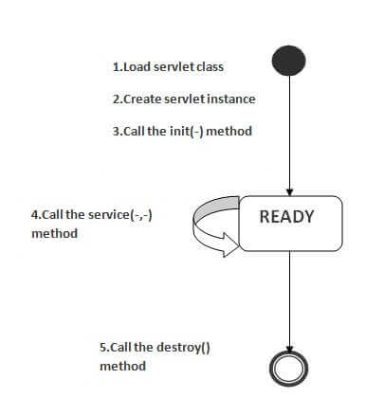
Life Cycle of a Servlet (Servlet Life Cycle)
The web container maintains the life cycle of a servlet instance. Let's see the life cycle of the servlet:
Servlet class is loaded.
Servlet instance is created.
init method is invoked.
service method is invoked.
destroy method is invoked.

Slide 48
SLC
1) Servlet class is loaded
The classloader is responsible to load the servlet class. The servlet class is loaded when the first request for the servlet is received by the web container.
2) Servlet instance is created
The web container creates the instance of a servlet after loading the servlet class. The servlet instance is created only once in the servlet life cycle.
3) init method is invoked
The web container calls the init method only once after creating the servlet instance. The init method is used to initialize the servlet. It is the life cycle method of the javax.servlet.Servlet interface. Syntax of the init method is given below:
public void init(ServletConfig config) throws ServletException
4) service method is invoked
The web container calls the service method each time when request for the servlet is received. If servlet is not initialized, it follows the first three steps as described above then calls the service method. If servlet is initialized, it calls the service method. Notice that servlet is initialized only once. The syntax of the service method of the Servlet interface is given below:
public void service(ServletRequest request, ServletResponse response)
throws ServletException, IOException
5) destroy method is invoked
The web container calls the destroy method before removing the servlet instance from the service. It gives the servlet an opportunity to clean up any resource for example memory, thread etc. The syntax of the destroy method of the Servlet interface is given below:
public void destroy()

Slide 49
Steps to create a servlet example
There are given 6 steps to create a servlet example. These steps are required for all the servers.
The servlet example can be created by three ways:
By implementing Servlet interface,
By inheriting GenericServlet class, (or)
By inheriting HttpServlet class
The mostly used approach is by extending HttpServlet because it provides http request specific method such as doGet(), doPost(), doHead() etc.
Here, we are going to use apache tomcat server in this example.

Slide 50
The steps are as follows:
Create a directory structure
Create a Servlet
Compile the Servlet
Create a deployment descriptor
Start the server and deploy the project
Access the servlet
https://www.javatpoint.com/steps-to-create-a-servlet-using-tomcat-server

Slide 51
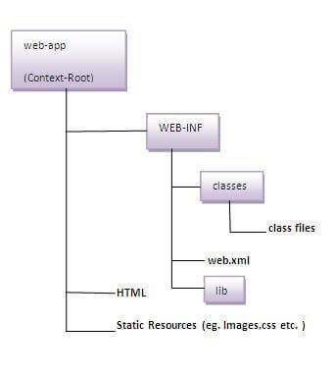
Create a directory structures
The directory structure defines that where to put the different types of files so that web container may get the information and respond to the client.
The Sun Microsystem defines a unique standard to be followed by all the server vendors. Let's see the directory structure that must be followed to create the servlet.
the servlet class file must be in the classes folder. The web.xml file must be under the WEB-INF folder.

Slide 52
Create a Servlet
There are three ways to create the servlet.
By implementing the Servlet interface
By inheriting the GenericServlet class
By inheriting the HttpServlet class
The HttpServlet class is widely used to create the servlet because it provides methods to handle http requests such as doGet(), doPost, doHead() etc.
DemoServlet.java
import javax.servlet.http.*;
import javax.servlet.*;
import java.io.*;
public class DemoServlet extends HttpServlet{
public void doGet(HttpServletRequest req,HttpServletResponse res)
throws ServletException,IOException
{
res.setContentType("text/html");//setting the content type
PrintWriter pw=res.getWriter();//get the stream to write the data
//writing html in the stream
pw.println("<html><body>");
pw.println("Welcome to servlet");
pw.println("</body></html>");
pw.close();//closing the stream
}}

Slide 53
Compile the servlet
For compiling the Servlet, jar file is required to be loaded. Different Servers provide different jar files:
Two ways to load the jar file
set classpath
paste the jar file in JRE/lib/ext folder
Put the java file in any folder. After compiling the java file, paste the class file of servlet in WEB-INF/classes directory.
Jar file | Server
1) servlet-api.jar | Apache Tomcat
2) weblogic.jar | Weblogic
3) javaee.jar | Glassfish
4) javaee.jar | JBoss

Slide 54
4)Create the deployment descriptor (web.xml file)
The deployment descriptor is an xml file, from which Web Container gets the information about the servet to be invoked.
The web container uses the Parser to get the information from the web.xml file. There are many xml parsers such as SAX, DOM and Pull.
There are many elements in the web.xml file. Here is given some necessary elements to run the simple servlet program.

Slide 55
Description of the elements of web.xml file
web.xml file
<web-app>
<servlet>
<servlet-name>sonoojaiswal</servlet-name>
<servlet-class>DemoServlet</servlet-class>
</servlet>
<servlet-mapping>
<servlet-name>sonoojaiswal</servlet-name>
</servlet-mapping>
</web-app>
<web-app> represents the whole application.<servlet> is sub element of <web-app> and represents the servlet.<servlet-name> is sub element of <servlet> represents the name of the servlet.<servlet-class> is sub element of <servlet> represents the class of the servlet.<servlet-mapping> is sub element of <web-app>. It is used to map the servlet.<url-pattern> is sub element of <servlet-mapping>. This pattern is used at client side to invoke the servlet.

Slide 56
Start the Server and deploy the project
To start Apache Tomcat server, double click on the startup.bat file under apache-tomcat/bin directory.
One Time Configuration for Apache Tomcat Server
You need to perform 2 tasks:
set JAVA_HOME or JRE_HOME in environment variable (It is required to start server).
Change the port number of tomcat (optional). It is required if another server is running on same port (8080).
1) How to set JAVA_HOME in environment variable?
To start Apache Tomcat server JAVA_HOME and JRE_HOME must be set in Environment variables.
Go to My Computer properties -> Click on advanced tab then environment variables -> Click on the new tab of user variable -> Write JAVA_HOME in variable name and paste the path of jdk folder in variable value -> ok -> ok -> ok.

Slide 57
How to access the servlet
http://localhost:9999/demo/welcome

Slide 58
ServletRequest Interface
An object of ServletRequest is used to provide the client request information to a servlet such as content type, content length, parameter names and values, header informations, attributes etc.
index.html
<form action="welcome" method="get">
Enter your name<input type="text" name="name"><br>
<input type="submit" value="login">
</form>

Slide 59
this keyword
DemoServ.java
import javax.servlet.http.*;
import javax.servlet.*;
import java.io.*;
public class DemoServ extends HttpServlet{
public void doGet(HttpServletRequest req,HttpServletResponse res)
throws ServletException,IOException
{
res.setContentType("text/html");
PrintWriter pw=res.getWriter();
String name=req.getParameter("name");//will return value
pw.println("Welcome "+name);
pw.close();
}}

Slide 60
RequestDispatcher in Servlet
The RequestDispatcher interface provides the facility of dispatching the request to another resource it may be html, servlet or jsp. This interface can also be used to include the content of another resource also. It is one of the way of servlet collaboration.
There are two methods defined in the RequestDispatcher interface.
Methods of RequestDispatcher interface
The RequestDispatcher interface provides two methods. They are:
public void forward(ServletRequest request,ServletResponse response)throws ServletException,java.io.IOException:Forwards a request from a servlet to another resource (servlet, JSP file, or HTML file) on the server.
public void include(ServletRequest request,ServletResponse response)throws ServletException,java.io.IOException:Includes the content of a resource (servlet, JSP page, or HTML file) in the response.

Slide 61
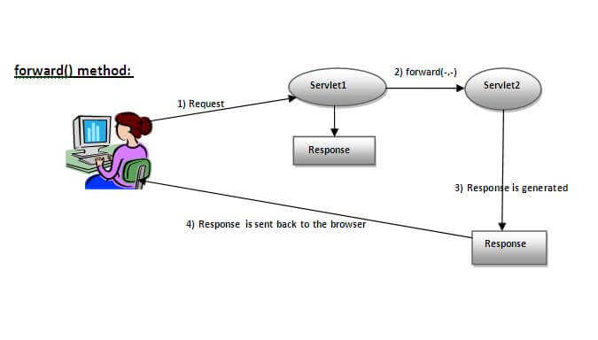
forward method
response of second servlet is sent to the client. Response of the first servlet is not displayed to the user

Slide 62
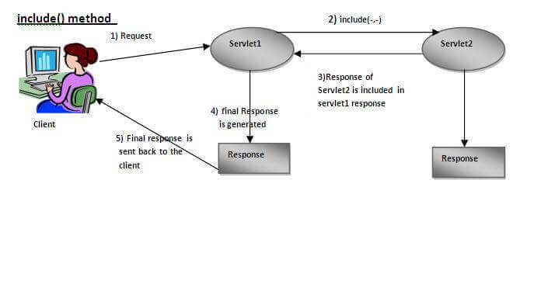
Include method
response of second servlet is included in the response of the first servlet that is being sent to the client.

Slide 63
How to get the object of RequestDispatcher
The getRequestDispatcher() method of ServletRequest interface returns the object of RequestDispatcher. Syntax:
Syntax of getRequestDispatcher method
public RequestDispatcher getRequestDispatcher(String resource);
Example of using getRequestDispatcher method
RequestDispatcher rd=request.getRequestDispatcher("servlet2");
//servlet2 is the url-pattern of the second servlet
rd.forward(request, response);//method may be include or forward

Slide 64
Example of RequestDispatcher interface
In this example, validating the password entered by the user. If password is servlet, it will forward the request to the WelcomeServlet, otherwise will show an error message: sorry username or password error!. In this program, we are cheking for hardcoded information.
index.html file: for getting input from the user.
Login.java file: a servlet class for processing the response. If password is servet, it will forward the request to the welcome servlet.
WelcomeServlet.java file: a servlet class for displaying the welcome message.
web.xml file: a deployment descriptor file that contains the information about the servlet.

Slide 65
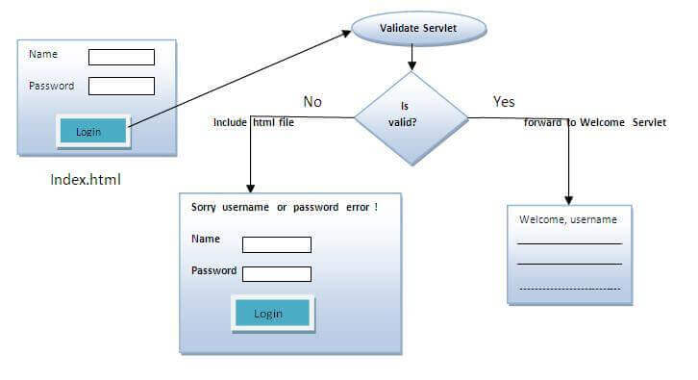
Example

Slide 66
Example
index.html
<form action="servlet1" method="post">
Name:<input type="text" name="userName"/><br/>
Password:<input type="password" name="userPass"/><br/>
<input type="submit" value="login"/>
</form>
Login.java
import java.io.*;
import javax.servlet.*;
import javax.servlet.http.*;
public class Login extends HttpServlet {
public void doPost(HttpServletRequest request, HttpServletResponse response)
throws ServletException, IOException {
response.setContentType("text/html");
PrintWriter out = response.getWriter();
String n=request.getParameter("userName");
String p=request.getParameter("userPass");
if(p.equals("servlet"){
RequestDispatcher rd=request.getRequestDispatcher("servlet2");
rd.forward(request, response);
}
else{
out.print("Sorry UserName or Password Error!");
RequestDispatcher rd=request.getRequestDispatcher("/index.html");
rd.include(request, response);
}
}
}

Slide 67
Example
WelcomeServlet.java
import java.io.*;
import javax.servlet.*;
import javax.servlet.http.*;
public class WelcomeServlet extends HttpServlet {
public void doPost(HttpServletRequest request, HttpServletRespose response)
throws ServletException, IOException {
response.setContentType("text/html");
PrintWriter out = response.getWriter();
String n=request.getParameter("userName");
out.print("Welcome "+n);
}
}
web.xml
<web-app>
<servlet>
<servlet-name>Login</servlet-name>
<servlet-class>Login</servlet-class>
</servlet>
<servlet>
<servlet-name>WelcomeServlet</servlet-name>
<servlet-class>WelcomeServlet</servlet-class>
</servlet>
<servlet-mapping>
<servlet-name>Login</servlet-name>
<url-pattern>/servlet1</url-pattern>
</servlet-mapping>
<servlet-mapping>
<servlet-name>WelcomeServlet</servlet-name>
<url-pattern>/servlet2</url-pattern>
</servlet-mapping>
<welcome-file-list>
<welcome-file>index.html</welcome-file>
</welcome-file-list>
</web-app>

Slide 68
SendRedirect in servlet
The sendRedirect() method of HttpServletResponse interface can be used to redirect response to another resource, it may be servlet, jsp or html file.
It accepts relative as well as absolute URL.
It works at client side because it uses the url bar of the browser to make another request. So, it can work inside and outside the server.

Slide 69
Example
DemoServlet.java
import java.io.*;
import javax.servlet.*;
import javax.servlet.http.*;
public class DemoServlet extends HttpServlet{
public void doGet(HttpServletRequest req,HttpServletResponse res)
throws ServletException,IOException
{
res.setContentType("text/html");
PrintWriter pw=res.getWriter();
response.sendRedirect("http://www.google.com");
pw.close();
}}
Creating custom google search using sendRedirect
In this example, we are using sendRedirect method to send request to google server with the request data.
index.html
<!DOCTYPE html>
<html>
<head>
<meta charset="ISO-8859-1">
<title>sendRedirect example</title>
</head>
<body>
<form action="MySearcher">
<input type="text" name="name">
<input type="submit" value="Google Search">
</form>
</body>
</html>
MySearcher.java
import java.io.IOException;
import javax.servlet.ServletException;
import javax.servlet.http.HttpServlet;
import javax.servlet.http.HttpServletRequest;
import javax.servlet.http.HttpServletResponse;
public class MySearcher extends HttpServlet {
protected void doGet(HttpServletRequest request, HttpServletResponse response)
throws ServletException, IOException {
String name=request.getParameter("name");
response.sendRedirect("https://www.google.co.in/#q="+name);
}
}

Slide 70
ServletConfig Interface
An object of ServletConfig is created by the web container for each servlet. This object can be used to get configuration information from web.xml file.
If the configuration information is modified from the web.xml file, we don't need to change the servlet. So it is easier to manage the web application if any specific content is modified from time to time.
The core advantage of ServletConfig is that you don't need to edit the servlet file if information is modified from the web.xml file.

Slide 71
Example of ServletConfig to get initialization parameter
getting the one initialization parameter from the web.xml file and printing this information in the servlet.
DemoServlet.java
import java.io.*;
import javax.servlet.*;
import javax.servlet.http.*;
public class DemoServlet extends HttpServlet {
public void doGet(HttpServletRequest request, HttpServletResponse response)
throws ServletException, IOException {
response.setContentType("text/html");
PrintWriter out = response.getWriter();
ServletConfig config=getServletConfig();
String driver=config.getInitParameter("driver");
out.print("Driver is: "+driver);
out.close();
}
}
web.xml
<web-app>
<servlet>
<servlet-name>DemoServlet</servlet-name>
<servlet-class>DemoServlet</servlet-class>
<init-param>
<param-name>driver</param-name>
<param-value>sun.jdbc.odbc.JdbcOdbcDriver</param-value>
</init-param>
</servlet>
<servlet-mapping>
<servlet-name>DemoServlet</servlet-name>
<url-pattern>/servlet1</url-pattern>
</servlet-mapping>
</web-app>

Slide 72
Example of ServletConfig to get all the initialization parameters
In this example, we are getting all the initialization parameter from the web.xml file and printing this information in the servlet.
DemoServlet.java
import java.io.IOException;
import java.io.PrintWriter;
import java.util.Enumeration;
import javax.servlet.ServletConfig;
import javax.servlet.ServletException;
import javax.servlet.http.HttpServlet;
import javax.servlet.http.HttpServletRequest;
import javax.servlet.http.HttpServletResponse;
public class DemoServlet extends HttpServlet {
public void doGet(HttpServletRequest request, HttpServletResponse response)
throws ServletException, IOException {
response.setContentType("text/html");
PrintWriter out = response.getWriter();
ServletConfig config=getServletConfig();
Enumeration<String> e=config.getInitParameterNames();
String str="";
while(e.hasMoreElements()){
str=e.nextElement();
out.print("<br>Name: "+str);
out.print(" value: "+config.getInitParameter(str));
}
out.close();
}
}
web.xml
<web-app>
<servlet>
<servlet-name>DemoServlet</servlet-name>
<servlet-class>DemoServlet</servlet-class>
<init-param>
<param-name>username</param-name>
<param-value>system</param-value>
</init-param>
<init-param>
<param-name>password</param-name>
<param-value>oracle</param-value>
</init-param>
</servlet>
<servlet-mapping>
<servlet-name>DemoServlet</servlet-name>
<url-pattern>/servlet1</url-pattern>
</servlet-mapping>
</web-app>

Slide 73
ServletContext Interface
An object of ServletContext is created by the web container at time of deploying the project. This object can be used to get configuration information from web.xml file. There is only one ServletContext object per web application.
If any information is shared to many servlet, it is better to provide it from the web.xml file using the <context-param> element.
Easy to maintain if any information is shared to all the servlet, it is better to make it available for all the servlet. We provide this information from the web.xml file, so if the information is changed, we don't need to modify the servlet. Thus it removes maintenance problem.
Use
The object of ServletContext provides an interface between the container and servlet.
The ServletContext object can be used to get configuration information from the web.xml file.
The ServletContext object can be used to set, get or remove attribute from the web.xml file.
The ServletContext object can be used to provide inter-application communication.

Slide 74
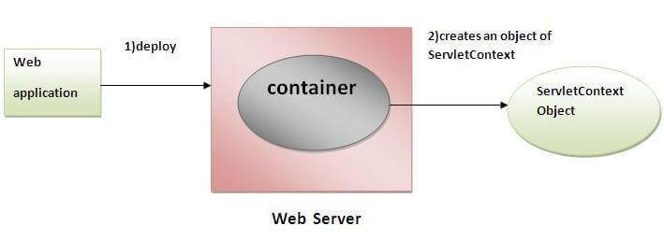
How to get the object of ServletContext interface
Difference between ServletConfig and ServletContext
The servletconfig object refers to the single servlet whereas servletcontext object refers to the whole web application.

Slide 75
How to get the object of ServletContext interface
getServletContext() method of ServletConfig interface returns the object of ServletContext.
getServletContext() method of GenericServlet class returns the object of ServletContext.
Syntax of getServletContext() method
public ServletContext getServletContext()
Example of getServletContext() method
//We can get the ServletContext object from ServletConfig object
ServletContext application=getServletConfig().getServletContext();
//Another convenient way to get the ServletContext object
ServletContext application=getServletContext();

Slide 76
Example of ServletContext to get the initialization parameter
In this example, we are getting the initialization parameter from the web.xml file and printing the value of the initialization parameter. Notice that the object of ServletContext represents the application scope. So if we change the value of the parameter from the web.xml file, all the servlet classes will get the changed value. So we don't need to modify the servlet. So it is better to have the common information for most of the servlets in the web.xml file by context-param element
DemoServlet.java
import java.io.*;
import javax.servlet.*;
import javax.servlet.http.*;
public class DemoServlet extends HttpServlet{
public void doGet(HttpServletRequest req,HttpServletResponse res)
throws ServletException,IOException
{
res.setContentType("text/html");
PrintWriter pw=res.getWriter();
//creating ServletContext object
ServletContext context=getServletContext();
//Getting the value of the initialization parameter and printing it
String driverName=context.getInitParameter("dname");
pw.println("driver name is="+driverName);
pw.close();
}}
web.xml
<web-app>
<servlet>
<servlet-name>sonoojaiswal</servlet-name>
<servlet-class>DemoServlet</servlet-class>
</servlet>
<context-param>
<param-name>dname</param-name>
<param-value>sun.jdbc.odbc.JdbcOdbcDriver</param-value>
</context-param>
<servlet-mapping>
<servlet-name>sonoojaiswal</servlet-name>
<url-pattern>/context</url-pattern>
</servlet-mapping>
</web-app>

Slide 77
Example of ServletContext to get all the initialization parameters
getting all the initialization parameter from the web.xml file. For getting all the parameters, we have used the getInitParameterNames() method in the servlet class.
DemoServlet.java
import java.io.*;
import javax.servlet.*;
import javax.servlet.http.*;
public class DemoServlet extends HttpServlet{
public void doGet(HttpServletRequest req,HttpServletResponse res)
throws ServletException,IOException
{
res.setContentType("text/html");
PrintWriter out=res.getWriter();
ServletContext context=getServletContext();
Enumeration<String> e=context.getInitParameterNames();
String str="";
while(e.hasMoreElements()){
str=e.nextElement();
out.print("<br> "+context.getInitParameter(str));
}
}}
web.xml
<web-app>
<servlet>
<servlet-name>sonoojaiswal</servlet-name>
<servlet-class>DemoServlet</servlet-class>
</servlet>
<context-param>
<param-name>dname</param-name>
<param-value>sun.jdbc.odbc.JdbcOdbcDriver</param-value>
</context-param>
<context-param>
<param-name>username</param-name>
<param-value>system</param-value>
</context-param>
<context-param>
<param-name>password</param-name>
<param-value>oracle</param-value>
</context-param>
<servlet-mapping>
<servlet-name>sonoojaiswal</servlet-name>
<url-pattern>/context</url-pattern>
</servlet-mapping>
</web-app>

Slide 78
Attribute in Servlet
An attribute in servlet is an object that can be set, get or removed from one of the following scopes:
request scope
session scope
application scope
The servlet programmer can pass informations from one servlet to another using attributes. It is just like passing object from one class to another so that we can reuse the same object again and again.

Slide 79
Example of ServletContext to set and get attribute
In this example, we are setting the attribute in the application scope and getting that value from another servlet.DemoServlet1.java
import java.io.*;
import javax.servlet.*;
import javax.servlet.http.*;
public class DemoServlet1 extends HttpServlet{
public void doGet(HttpServletRequest req,HttpServletResponse res)
{
try{
res.setContentType("text/html");
PrintWriter out=res.getWriter();
ServletContext context=getServletContext();
context.setAttribute("company","IBM");
out.println("Welcome to first servlet");
out.println("<a href='servlet2'>visit</a>");
out.close();
}catch(Exception e){out.println(e);}
}}
DemoServlet2.java
import java.io.*;
import javax.servlet.*;
import javax.servlet.http.*;
public class DemoServlet2 extends HttpServlet{
public void doGet(HttpServletRequest req,HttpServletResponse res)
{
try{
res.setContentType("text/html");
PrintWriter out=res.getWriter();
ServletContext context=getServletContext();
String n=(String)context.getAttribute("company");
out.println("Welcome to "+n);
out.close();
}catch(Exception e){out.println(e);}
}}
web.xml
<web-app>
<servlet>
<servlet-name>s1</servlet-name>
<servlet-class>DemoServlet1</servlet-class>
</servlet>
<servlet-mapping>
<servlet-name>s1</servlet-name>
<url-pattern>/servlet1</url-pattern>
</servlet-mapping>
<servlet>
<servlet-name>s2</servlet-name>
<servlet-class>DemoServlet2</servlet-class>
</servlet>
<servlet-mapping>
<servlet-name>s2</servlet-name>
<url-pattern>/servlet2</url-pattern>
</servlet-mapping>
</web-app

Slide 80
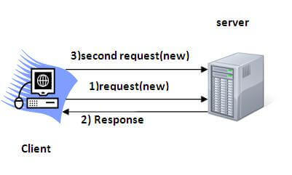
Session Tracking/Session Management
Session - a particular interval of time.
Session Tracking is a way to maintain state (data) of an user.
Http protocol is a stateless so need to maintain state using session tracking techniques. Each time user requests to the server, server treats the request as the new request. So we need to maintain the state of an user to recognize to particular user.
HTTP is stateless that means each request is considered as the new request. It is shown in the figure given below:
Why use Session Tracking?
To recognize the user It is used to recognize the particular user.

Slide 81
Session Tracking Techniques
There are four techniques used in Session tracking:
Cookies
Hidden Form Field
URL Rewriting
HttpSession

Slide 82
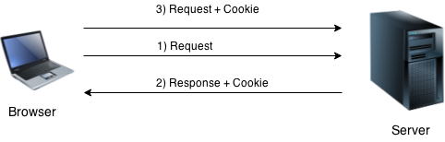
Cookies
A cookie is a small piece of information that is persisted between the multiple client requests.
A cookie has a name, a single value, and optional attributes such as a comment, path and domain qualifiers, a maximum age, and a version number.
How Cookie works
By default, each request is considered as a new request. In cookies technique, we add cookie with response from the servlet. So cookie is stored in the cache of the browser. After that if request is sent by the user, cookie is added with request by default. Thus, we recognize the user as the old user.

Slide 83
Types of Cookie
There are 2 types of cookies in servlets.
Non-persistent cookie
Persistent cookie
Non-persistent cookie
It is valid for single session only. It is removed each time when user closes the browser.
Persistent cookie
It is valid for multiple session . It is not removed each time when user closes the browser. It is removed only if user logout or signout.
Advantage of Cookies
Simplest technique of maintaining the state.
Cookies are maintained at client side.
Disadvantage of Cookies
It will not work if cookie is disabled from the browser.
Only textual information can be set in Cookie object.

Slide 84
How create/delete/get/cookie
create cookie.
Cookie ck=new Cookie("user","sonoo jaiswal");//creating cookie object
response.addCookie(ck);//adding cookie in the response
delete Cookie
It is mainly used to logout or signout the user.
Cookie ck=new Cookie("user","");//deleting value of cookie
ck.setMaxAge(0);//changing the maximum age to 0 seconds
response.addCookie(ck);//adding cookie in the response
get Cookies
to get all the cookies.
Cookie ck[]=request.getCookies();
for(int i=0;i<ck.length;i++){
out.print("<br>"+ck[i].getName()+" "+ck[i].getValue());//printing name and value of cookie
}

Slide 85
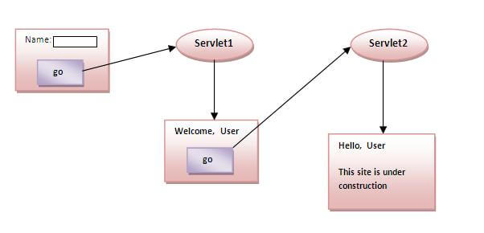
Example
storing the name of the user in the cookie object and accessing it in another servlet. As we know well that session corresponds to the particular user. So if you access it from too many browsers with different values, you will get the different value.

Slide 86
index.html
<form action="servlet1" method="post">
Name:<input type="text" name="userName"/><br/>
<input type="submit" value="go"/>
</form>

Slide 87
FirstServlet.java
import java.io.*;
import javax.servlet.*;
import javax.servlet.http.*;
public class FirstServlet extends HttpServlet {
public void doPost(HttpServletRequest request, HttpServletResponse response){
try{
response.setContentType("text/html");
PrintWriter out = response.getWriter();
String n=request.getParameter("userName");
out.print("Welcome "+n);
Cookie ck=new Cookie("uname",n);//creating cookie object
response.addCookie(ck);//adding cookie in the response
//creating submit button
out.print("<form action='servlet2'>");
out.print("<input type='submit' value='go'>");
out.print("</form>");
out.close();
}catch(Exception e){System.out.println(e);}
}
}

Slide 88
SecondServlet.java
import java.io.*;
import javax.servlet.*;
import javax.servlet.http.*;
public class SecondServlet extends HttpServlet {
public void doPost(HttpServletRequest request, HttpServletResponse response){
try{
response.setContentType("text/html");
PrintWriter out = response.getWriter();
Cookie ck[]=request.getCookies();
out.print("Hello "+ck[0].getValue());
out.close();
}catch(Exception e){System.out.println(e);}
}
}

Slide 89
web.xml
https://www.javatpoint.com/servlet-login-and-logout-example-using-cookies
<web-app>
<servlet>
<servlet-name>s1</servlet-name>
<servlet-class>FirstServlet</servlet-class>
</servlet>
<servlet-mapping>
<servlet-name>s1</servlet-name>
<url-pattern>/servlet1</url-pattern>
</servlet-mapping>
<servlet>
<servlet-name>s2</servlet-name>
<servlet-class>SecondServlet</servlet-class>
</servlet>
<servlet-mapping>
<servlet-name>s2</servlet-name>
<url-pattern>/servlet2</url-pattern>
</servlet-mapping>
</web-app>

Slide 90
Hidden Form Field
In case of Hidden Form Field a hidden (invisible) textfield is used for maintaining the state of an user.
In such case, we store the information in the hidden field and get it from another servlet. This approach is better if we have to submit form in all the pages and we don't want to depend on the browser.
Let's see the code to store value in hidden field.
<input type="hidden" name="uname" value="Vimal Jaiswal">
Here, uname is the hidden field name and Vimal Jaiswal is the hidden field value.

Slide 91
Hidden Field
Real application of hidden form field
It is widely used in comment form of a website. In such case, we store page id or page name in the hidden field so that each page can be uniquely identified.
Advantage of Hidden Form Field
It will always work whether cookie is disabled or not.
Disadvantage of Hidden Form Field:
It is maintained at server side.
Extra form submission is required on each pages.
Only textual information can be used.

Slide 92
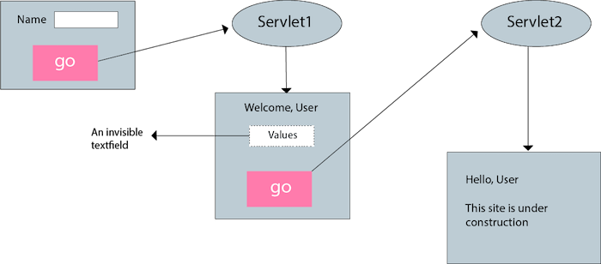
Example of using Hidden Form Field

Slide 93
Ex
index.html
<form action="servlet1">
Name:<input type="text" name="userName"/><br/>
<input type="submit" value="go"/>
</form>
FirstServlet.java
import java.io.*;
import javax.servlet.*;
import javax.servlet.http.*;
public class FirstServlet extends HttpServlet {
public void doGet(HttpServletRequest request, HttpServletResponse response){
try{
response.setContentType("text/html");
PrintWriter out = response.getWriter();
String n=request.getParameter("userName");
out.print("Welcome "+n);
//creating form that have invisible textfield
out.print("<form action='servlet2'>");
out.print("<input type='hidden' name='uname' value='"+n+"'>");
out.print("<input type='submit' value='go'>");
out.print("</form>");
out.close();
}catch(Exception e){System.out.println(e);}
}
}

Slide 94
Ex
SecondServlet.java
import java.io.*;
import javax.servlet.*;
import javax.servlet.http.*;
public class SecondServlet extends HttpServlet {
public void doGet(HttpServletRequest request, HttpServletResponse response)
try{
response.setContentType("text/html");
PrintWriter out = response.getWriter();
//Getting the value from the hidden field
String n=request.getParameter("uname");
out.print("Hello "+n);
out.close();
}catch(Exception e){System.out.println(e);}
}
}
web.xml
<web-app>
<servlet>
<servlet-name>s1</servlet-name>
<servlet-class>FirstServlet</servlet-class>
</servlet>
<servlet-mapping>
<servlet-name>s1</servlet-name>
<url-pattern>/servlet1</url-pattern>
</servlet-mapping>
<servlet>
<servlet-name>s2</servlet-name>
<servlet-class>SecondServlet</servlet-class>
</servlet>
<servlet-mapping>
<servlet-name>s2</servlet-name>
<url-pattern>/servlet2</url-pattern>
</servlet-mapping>
</web-app>

Slide 95
URL rewriting
URL rewriting, we append a token or identifier to the URL of the next Servlet or the next resource. We can send parameter name/value pairs using the following format:
url?name1=value1&name2=value2&??
A name and a value is separated using an equal = sign, a parameter name/value pair is separated from another parameter using the ampersand(&). When the user clicks the hyperlink, the parameter name/value pairs Advantage of URL Rewriting
It will always work whether cookie is disabled or not (browser independent).
Extra form submission is not required on each pages.
Disadvantage of URL Rewriting
It will work only with links.
It can send Only textual information.

Slide 96
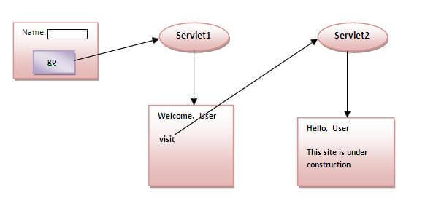
Example

Slide 97
Example
index.html
<form action="servlet1">
Name:<input type="text" name="userName"/><br/>
<input type="submit" value="go"/>
</form>
FirstServlet.java
import java.io.*;
import javax.servlet.*;
import javax.servlet.http.*;
public class FirstServlet extends HttpServlet {
public void doGet(HttpServletRequest request, HttpServletResponse response){
try{
response.setContentType("text/html");
PrintWriter out = response.getWriter();
String n=request.getParameter("userName");
out.print("Welcome "+n);
//appending the username in the query string
out.print("<a href='servlet2?uname="+n+"'>visit</a>");
out.close();
}catch(Exception e){System.out.println(e);}
}
}

Slide 98
Example
SecondServlet.java
import java.io.*;
import javax.servlet.*;
import javax.servlet.http.*;
public class SecondServlet extends HttpServlet {
public void doGet(HttpServletRequest request, HttpServletResponse response)
try{
response.setContentType("text/html");
PrintWriter out = response.getWriter();
//getting value from the query string
String n=request.getParameter("uname");
out.print("Hello "+n);
out.close();
}catch(Exception e){System.out.println(e);}
}
}
web.xml
<web-app>
<servlet>
<servlet-name>s1</servlet-name>
<servlet-class>FirstServlet</servlet-class>
</servlet>
<servlet-mapping>
<servlet-name>s1</servlet-name>
<url-pattern>/servlet1</url-pattern>
</servlet-mapping>
<servlet>
<servlet-name>s2</servlet-name>
<servlet-class>SecondServlet</servlet-class>
</servlet>
<servlet-mapping>
<servlet-name>s2</servlet-name>
<url-pattern>/servlet2</url-pattern>
</servlet-mapping>
</web-app>

Slide 99
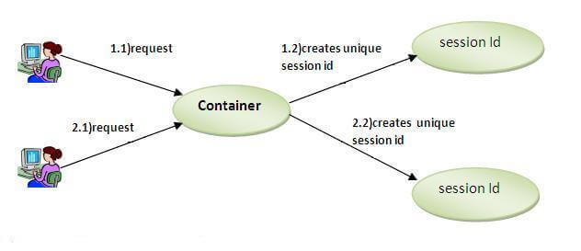
HttpSession interface
In such case, container creates a session id for each user.The container uses this id to identify the particular user.An object of HttpSession can be used to perform two tasks:
bind objects
view and manipulate information about a session, such as the session identifier, creation time, and last accessed time.

Slide 100
HttpSession
How to get the HttpSession object ?
The HttpServletRequest interface provides two methods to get the object of HttpSession:
public HttpSession getSession():Returns the current session associated with this request, or if the request does not have a session, creates one.
public HttpSession getSession(boolean create):Returns the current HttpSession associated with this request or, if there is no current session and create is true, returns a new session.
Commonly used methods of HttpSession interface
public String getId():Returns a string containing the unique identifier value.
public long getCreationTime():Returns the time when this session was created, measured in milliseconds since midnight January 1, 1970 GMT.
public long getLastAccessedTime():Returns the last time the client sent a request associated with this session, as the number of milliseconds since midnight January 1, 1970 GMT.
public void invalidate():Invalidates this session then unbinds any objects bound to it.

Slide 101
Example of using HttpSession
index.html
<form action="servlet1">
Name:<input type="text" name="userName"/><br/>
<input type="submit" value="go"/>
</form>
FirstServlet.java
import java.io.*;
import javax.servlet.*;
import javax.servlet.http.*;
public class FirstServlet extends HttpServlet {
public void doGet(HttpServletRequest request, HttpServletResponse response){
try{
response.setContentType("text/html");
PrintWriter out = response.getWriter();
String n=request.getParameter("userName");
out.print("Welcome "+n);
HttpSession session=request.getSession();
session.setAttribute("uname",n);
out.print("<a href='servlet2'>visit</a>");
out.close();
}catch(Exception e){System.out.println(e);}
}
}
SecondServlet.java
import java.io.*;
import javax.servlet.*;
import javax.servlet.http.*;
public class SecondServlet extends HttpServlet {
public void doGet(HttpServletRequest request, HttpServletResponse response)
try{
response.setContentType("text/html");
PrintWriter out = response.getWriter();
HttpSession session=request.getSession(false);
String n=(String)session.getAttribute("uname");
out.print("Hello "+n);
out.close();
}catch(Exception e){System.out.println(e);}
}
}
web.xml
<web-app>
<servlet>
<servlet-name>s1</servlet-name>
<servlet-class>FirstServlet</servlet-class>
</servlet>
<servlet-mapping>
<servlet-name>s1</servlet-name>
<url-pattern>/servlet1</url-pattern>
</servlet-mapping>
<servlet>
<servlet-name>s2</servlet-name>
<servlet-class>SecondServlet</servlet-class>
</servlet>
<servlet-mapping>
<servlet-name>s2</servlet-name>
<url-pattern>/servlet2</url-pattern>
</servlet-mapping>
</web-app>

